Slide 1
ROBERT BROWN
In 1827 Robert Brown, a British botanist, is observing a suspended pollen grain in water. While looking at this pollen grain underneath a microscope, he notices that it undergoes a type of random walk. The figure below depicts the type of random, seemingly unpredictable motion, that the suspended particle underwent.

Slide 2
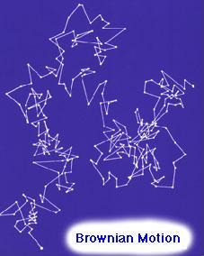
This random motion is now referred to as BROWNIAN MOTION, but the motion itself may be easily remembered as the "Drunken Sailor Walk". At first Brown attributed this motion to signs of life. However, when he repeated the experiment with an inorganic body he observed the same motion.

Slide 3
TWO VIEWS
ENERGETICS
1. View the world through macroscopic properties like V, P, T, Energy
2. Use Classical Thermodynamics to explain phenomenon, like ideal gas behaviour
3. NO such thing as pariticles! They believed that you could cut up matter into smaller and smaller pieces indefinitely.
ATOMISTS
View the world through microscopic properties, existence of particles
2. Use the Molecular Kinetic Theory of Heat to explain phenomenon
3. Fluids behave AS IF they are composed of particles, matter is discrete

Slide 4
EINSTEIN
EINSTEIN ASSUMES
1. Liquid is composed of atoms
2. Atoms are in constant motion
Einstein expected that the atoms inthe liquid would be constantly colliding with the suspended body. Since the atoms are totally random in the liquid, the collisions between them and the suspended body will happen at random causing the suspended body to undergo a type of random motion.
Does Einstein's model explain motion quantitatively?
Simply put, does Einstein's model predict exact results from a Brownian motion experiment?
Einstein's assumptions, that the liquid is composed of atoms which are in constant motion, provide the correct qualitative results for describing Brownian motion. However the question still remains, Does Einstein's model predict the correct quantitative results?

Slide 5
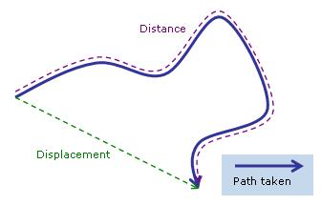
The displacement of a body
Now we wish to discuss the concept of displacement and how it pertains to a suspended body undergoing Brownian motion. First of all there is a major difference between distance traveled and your displacement.

Slide 6
CLASSICALLY For a classical particle, like a billiard ball or a car, the displacement is proportional to time. This means that if I was driving to the grocery store I wanted to figure out my displacement from home, I would take my velocity and multiply it by the time it took for me to get there! This may be expressed mathematically as displacement = velocity x time We can see that the displacement is proportional to time for classical bodies.
BROWNIAN MOTION For a suspended body undergoing Brownian motion, experiments have shown that it's displacement is proportional to the square root of time. This may be expressed mathematically as
displacement α √t As a result, there is a large discrepancy between what we would expect of a classical particle and a particle undergoing Brownian motion.

Slide 7
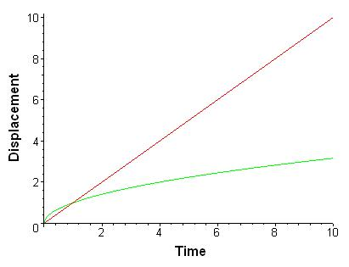
From this figure, even after 10 units of time there is a large discrepancy between the classical displacement in red and the Brownian motion displacement in green. Using a statistical analysis
d= √Dt
D, is known as the diffusion coefficient. It is also observed that Einstein's derived expression quantitatively matches the displacement found from a Brownian motion experiment.

Slide 8
Einstein's Paper + Brownian Motion + Perrin's Experiments = Existence of Atoms
Einstein's 1905 paper described how a suspended body should displace in a liquid over time, assuming the liquid was composed of atoms. In 1908, when Jean Perrin completed Brownian motion experiments which accurately measured the displacement and the time of the suspended body. These values matched Einstein's predictions and provided the first indisputible evidence for the existence of atoms!!
The calculation of Avogadro's number using a Brownian motion experiment was also performed by Jean Perrin in 1908
The molar gas constant R is defined as Avogadro's number times the Boltzmann constant. The physical significance of k is that it provides a measure of the amount of energy (i.e., heat) corresponding to the random thermal motions of the particles making up a substance.
Einstein's most referenced work is his paper on Brownian motion. This is a result of that fact that Brownian motion provides an enormous amount of applications to the modern day world!

Slide 9
Properties of the Brownian motion function
1. Independent: This means that where you are right now does not effect where you are going to be. An example of a motion that is dependent is a ball on the hill. If the ball is at the top of the hill it must roll down. We conclude that it's next position is directly related to it's postion the moment before.
2. Isotropic: This means that you are just as likely to move in any direction. There is NO preferred direction of travel.
3. Random: This means that you do not know how much you are going to move in that direction. This Brownian motion function can be graphed in 1 dimension or 2 dimension

Slide 10
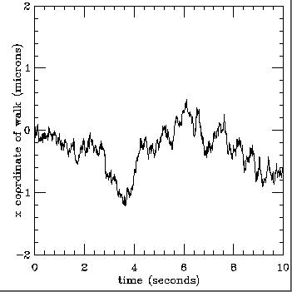
1D BROWNIAN MOTION FUNCTION

Slide 11
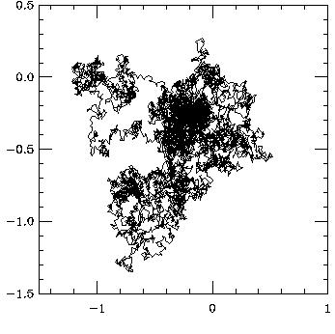
2D BROWNIAN MOTION FUNCTION

Slide 12
It should be noted that there is a large amount of mathematical complexity behind the actual expression of the Brownian motion function, and its application to real world problems. However, without having any understanding of the function except for its properties and its graphs, you can still get an appreciation of its usefulness.

Slide 13
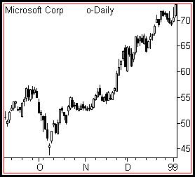
Applications
1. Stock Market - Here it is applied in order to gain an understanding of how a stock price will vary over a certain period time.

Slide 14

2. Robotic Navigation - Here it is used to assist in remotely guiding a robot through rough terrain. A recent example of where this was used is in the Mars Rover. Since the scientists do not know exactly how the terrain is going to be on Mars they assume it to be random. As a result, applying the Brownian motion function, assist in the remote navigation of the Rover.

Slide 15

3. Scheduling Problems - Here it is used in computer networks or neural networks in order to determine the optimal sequence of handling tasks. Under this application it may also be applied to the manufacturing industry, in order to help production become more efficient.

Slide 16

4. Medical Imaging - In this situation the Brownian motion function is used to help in image classification. In this sense it is used to help predict the seemingly random shape along the image boundary.

Slide 17

5. Estimation of Extreme Weather - Here we use the Brownian motion function in attempts to estimate areas that had received extreme weather, such as flooding and drought, centuries ago. It may also be used to predict future events of extreme weather.

